Slide 1
The Routing Table: A Closer Look

Slide 2
Objectives
Describe the various route types found in the routing table structure
Describe the routing table lookup process.
Describe routing behavior in routed networks.

Slide 3
Introduction
Chapter Focus
-Structure of the routing table
-Lookup process of the routing table
-Classless and classful routing behaviors

Slide 4
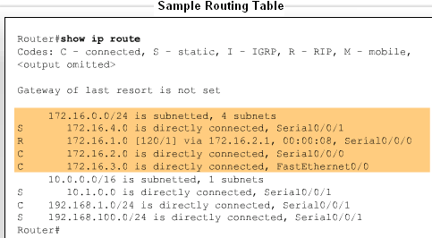
Routing Table Structure
Routing table entries come from the following sources
  -Directly connected networks
  -Static routes
  -Dynamic routing protocols

Slide 5
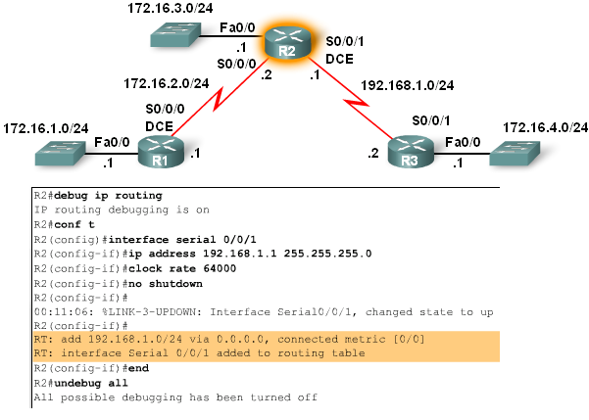
Routing Table Structure
Level 1 Routes
As soon as the no shutdown command is issued the route is added to routing table

Slide 6
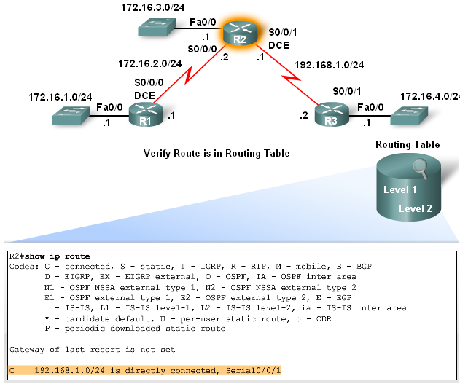
Routing Table Structure
Cisco IP routing table is a hierarchical structure
-The reason for this is to speed up lookup process

Slide 7
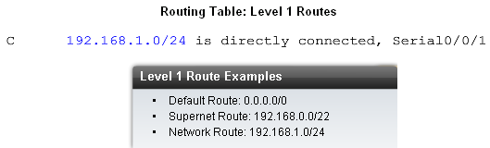
Routing Table Structure
Level 1 Routes
-Have a subnet mask equal to or less than the classful mask of the network address.
Level 1 route can function as
-Default route
-Supernet route
-Network route

Slide 8
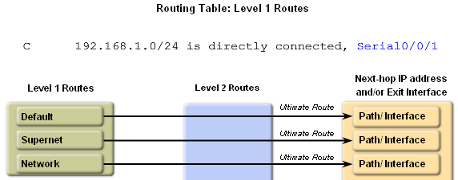
Routing Table Structure
Level 1 Routes
  -Ultimate Route
    Includes either:
-A next-hop address
OR
-An exit interface

Slide 9
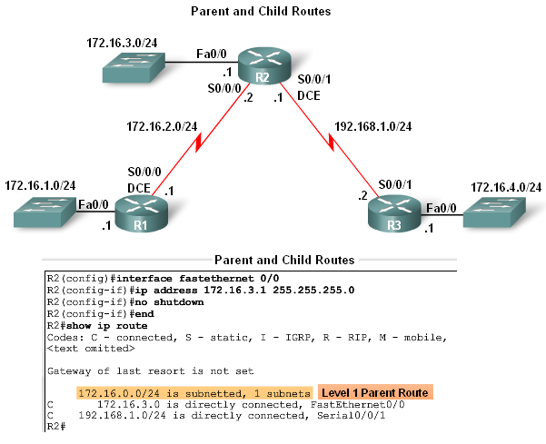
Routing Table Structure
Parent and Child Routes
-A parent route is a level 1 route
-A parent route does not contain any next-hop IP address or exit interface information

Slide 10
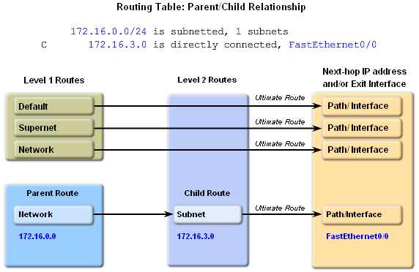
Routing Table Structure
Automatic creation of parent routes
  -Occurs any time a subnet is added to the routing table
Child routes
-Child routes are level 2 routes
-Child routes are a subnet of a classful network address

Slide 11
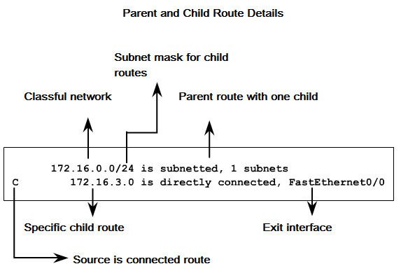
Routing Table Structure
Level 2 child routes contain route source & the network address of the route
Level 2 child routes are also considered ultimate routes
Reason: they contain the next hop address &/or exit interface

Slide 12
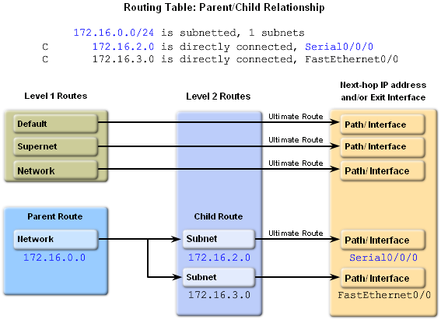
Routing Table Structure
Both child routes have the same subnet mask
-This means the parent route maintains the /24 mask

Slide 13
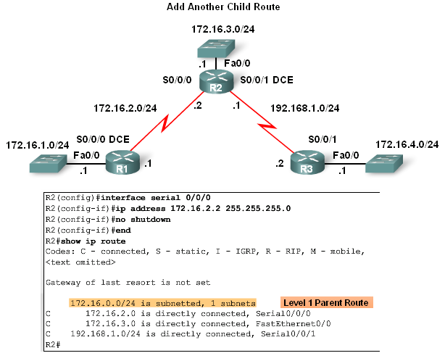
Routing Table Structure
Diagram illustrates 2 child networks belonging to the parent route 172.16.0.0 / 24

Slide 14
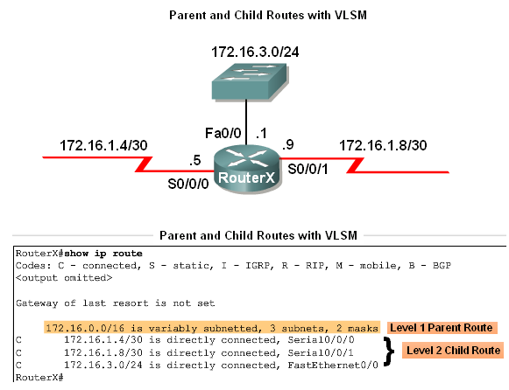
Routing Table Structure
In classless networks, child routes do not have to share the same subnet mask

Slide 15
Routing Table Structure
Parent & Child Routes: Classless Networks
Network Type | Parent route’s Classful mask is Displayed | Term variably subnetted is seen in parent route in routing table | Includes the # of different masks of child routes | Subnet mask included with each child route entry
Class- ful | No | No | No | No
Class-less | Yes | Yes | Yes | Yes

Slide 16
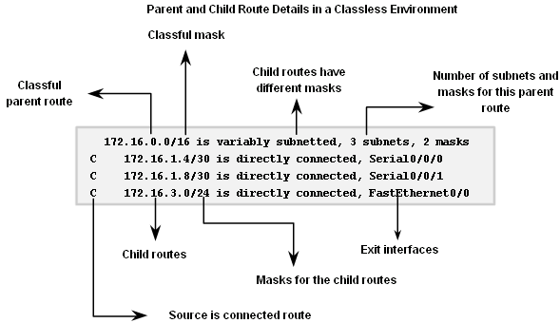
Routing Table Structure
Parent & Child Routes: Classless Networks

Slide 17
Routing Table Lookup Process
The Route Lookup Process
    Examine level 1 routes
      -If best match a level 1 ultimate route and is not a parent route this route is used to forward packet
    Router examines level 2 (child) routes
      -If there is a match with level 2 child route then
        that subnet is used to forward packet
      -If no match then
      determine routing behavior type
    Router determines classful or classless routing behavior
      -If classful then packet is dropped
      -If classless then router searches level one supernet and default routes
      -If there exists a level 1 supernet or default route match then Packet is forwarded. If not packet is dropped

Slide 18
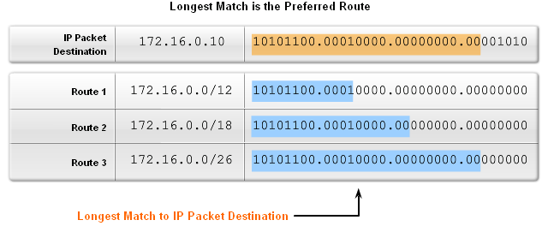
Routing Table Lookup Process
Longest Match: Level 1 Network Routes
  Best match is also known as the longest match
  The best match is the one that has the most number of left most bits matching between the destination IP address and the route in the routing table.

Slide 19
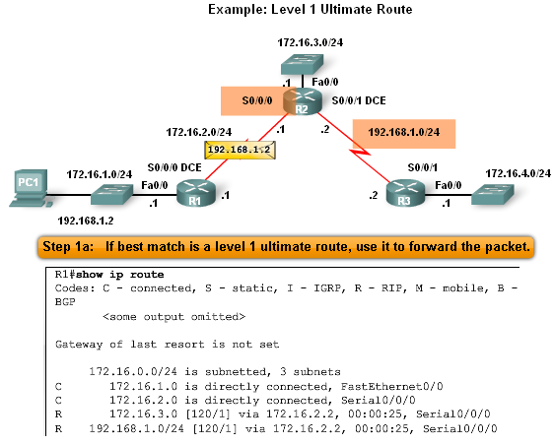
Routing Table Lookup Process
Finding the subnet mask used to determine the longest match
Scenario:
  PC1 pings 192.168.1.2
  Router examines level 1 route for best match
  There exist a match between192.168.1.2 & 192.168.1.0 / 24
  Router forwards packets out s0/0/0

Slide 20
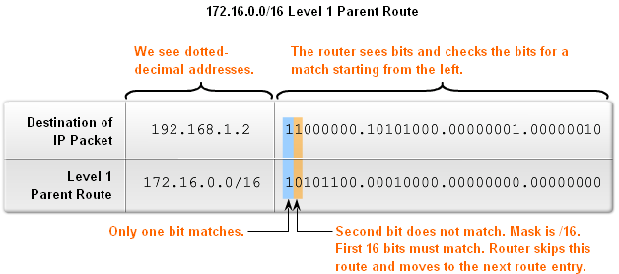
Routing Table Lookup Process
The process of matching
-1st there must be a match made between the parent route & destination IP
      -If a match is made then an attempt at finding a match between the destination IP and the child route is made.

Slide 21
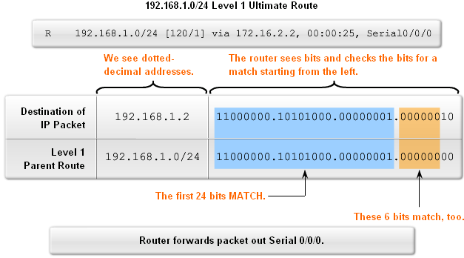
Routing Table Lookup Process
Finding a match between packet’s destination IP address and the next route in the routing table
-The figure shows a match between the destination IP of 192.168.1.0 and the level one IP of 192.168.1.0 / 24 then packet forwarded out s0/0/0

Slide 22
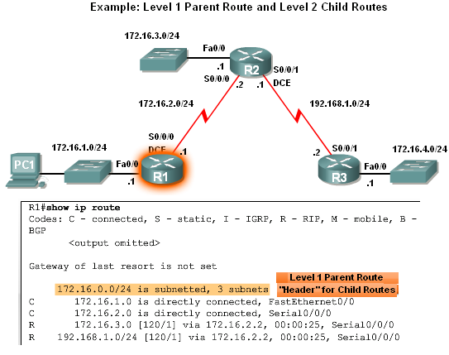
Routing Table Lookup Process
Before level 2 child routes are examined
-There must be a match between classful level one parent route and destination IP address.

Slide 23
Routing Table Lookup Process
After the match with parent route has been made Level 2 child routes will be examined for a match
-Route lookup process searches for child routes with a match with destination IP

Slide 24
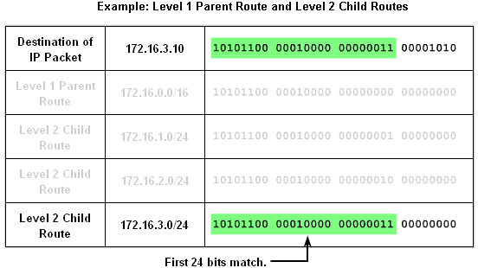
Routing Table Lookup Process
How a router finds a match with one of the level 2 child routes
-First router examines parent routes for a match
-If a match exists then:
        Child routes are examined
        Child route chosen is the one with the longest match

Slide 25
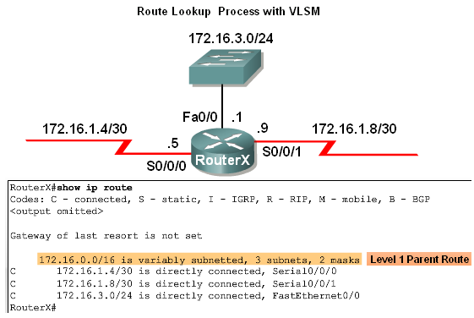
Routing Table Lookup Process
Example: Route Lookup Process with VLSM
-The use of VLSM does not change the lookup process
-If there is a match between destination IP address and the level 1 parent route then
-Level 2 child routes will be searched

Slide 26
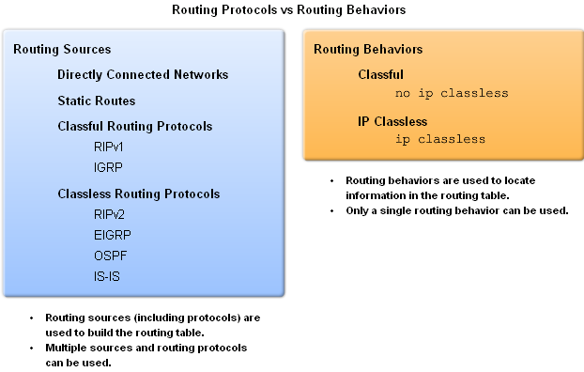
Routing Behavior
Classful & classless routing protocols
Influence how routing table is populated
Classful & classless routing behaviors
Determines how routing table is searched after it is filled

Slide 27
Routing Behavior
Classful Routing Behavior – Search Process
The reason why the router will not search beyond the child routes
        Originally networks were all classful
        This meant an organization could subnet a major network address and “enlighten” all the organization’s routers about the subnetting
        Therefore, if the subnet was not in the routing table, the subnet did not exist and packet was dropped

Slide 28
Routing Behavior
ip Classless
Beginning with IOS 11.3, ip classless was configured by default
Classless routing behavior works for
-Discontiguous networks
And
-CIDR supernets

Slide 29
Routing Behavior
Classless Routing Behavior: ip classless
Route lookup process when ip classless is in use
-If classless routing behavior in effect then
        Search level 1 routes
        Supernet routes Checked first
        If a match exists then forward packet
        Default routes Checked second
If there is no match or no default route then the
        Packet is dropped

Slide 30
Routing Behavior
Classful vs. Classless Routing Behavior
-It is recommended to use classless routing behavior
      Reason: so supernet and default routes can be used whenever needed

